Slide 1
China: Warring States to Empire
Qin Dynasty
Part of the Classical China’s History

Slide 2
Creation of the Empire
Regarded as restoration
Xia, Shang, and Zhou dynasties had created a Chinese state
Fell apart by 500 BCE
Age of warring states
Seven competing kingdoms
Multiple states were thought to be unnatural

Slide 3
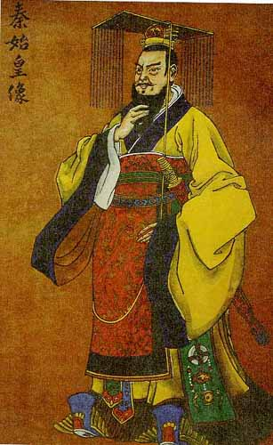
Qin Dynasty
Emerges out of end of Zhou Dynasty/Period of Warring States
Founder: Shi Huangdi (“First Emperor”)
Goals:
Unify and expand China
Restore order

Slide 4
Unification by Shi huangdi
Ruler of Qin, 221-210 BCE
Adopted legalism as political philosophy
Clear rules and harsh punishments to enforce state authority

Slide 5
Legalism
Practical, political reaction to Confucianism
Han Feizi - 3rd century BCE
Powerful and efficient government is key to restoring order
Laws will end civil war and restore harmony
Rewards to good subjects and punish disobedient
Rulers must control ideas and actions of people
Favored by Shi Huangdi during Qin dyansty

Slide 6
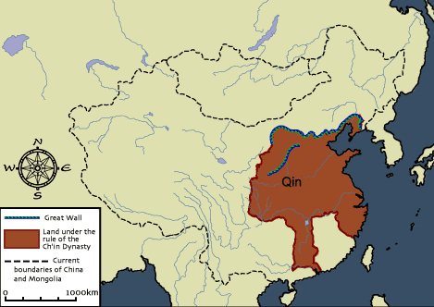

Slide 7
Life in the Qin Dynasty
Social
Primogeniture eliminated (practice of having eldest son inherit all property and land)
Nobles must leave land and live in Emperor’s court
Political
Emperor had complete control over all aspects of society
Use of brutality and force to accomplish goals (Great Wall)
Bureaucracy (not of the nobility) expanded to help control all regions
National census
Single law code
Interactions
Army expanded to crush rivals and regional rebellions
Expanded territory of China, including Hong Kong
Influenced parts of Vietnam through conquest
Expanded infrastructure to increase interactions

Slide 8
Cultural
Confucianism looked down upon and followers persecuted
Legalism promoted
Architectural: Initiates construction of Great Wall; Terracotta Soldiers/Tomb of Shi Huangdi
Uniform written language
Banned books
Economic
Introduced standard weights and measures
Eliminated the very rare practice of slavery
Forced labor necessary for construction projects
Extremely high taxes
Sponsored agricultural projects (irrigation) and manufacturing of silk

Slide 9
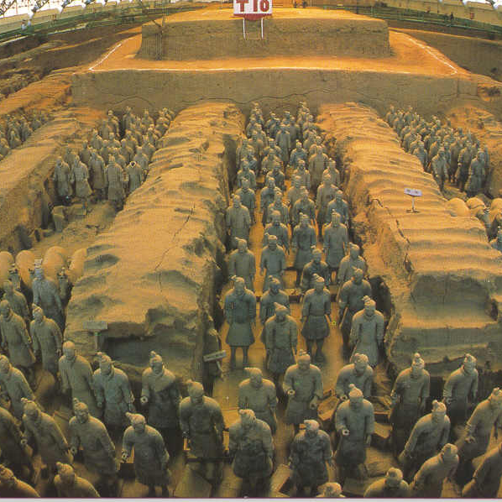
Terracotta Soldiers/Tomb of Shi Huangdi

Slide 10
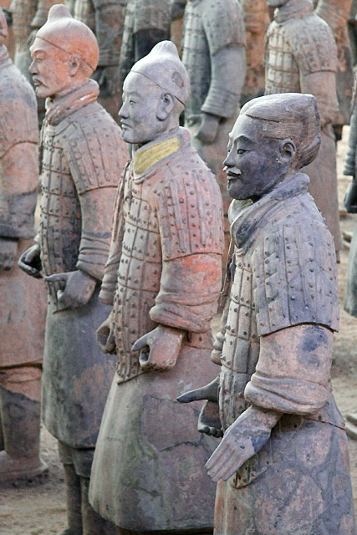
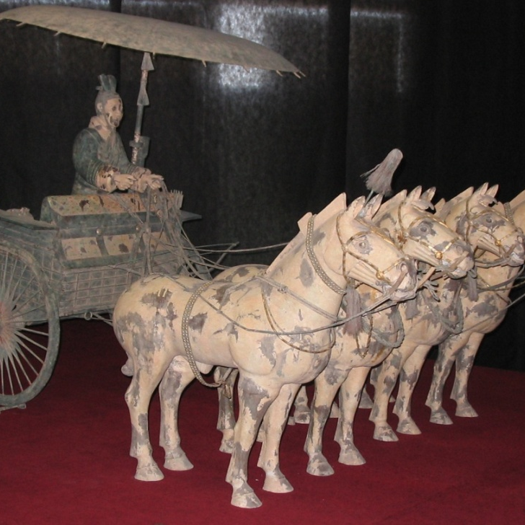

Slide 11
Positive Creation
Standardized weights, measurements
Currency
Written chinese
Axle lengths for carts

Slide 12
Qin Dynasty Collapses
Shi Huangdi
Extremely paranoid; killed off suspected enemies (nobles, intellectuals, warlords)
Desire to control EVERYTHING
High taxes, forced labor
Shi Huangdi dies in 210 BCE; followed by 8 years of peasant revolts to determine successor - winner establishes Han Dynasty
Collapses 206 BCE
Han dynasty 206 BCE-220 CE
Kept Qin centralization
Less harsh

